Slide 1
Linear modelling theory
With continuous explanatory variables

Slide 2
The question

Slide 3
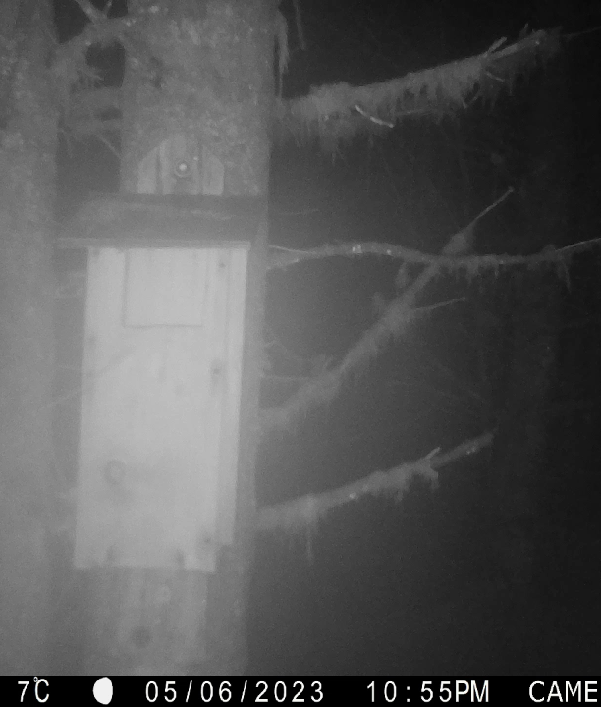
Predated predators
Pine martens are expanding their range south in UK
Recolonising predators that can disrupt balance that has built up since their local extinction
Many species already struggling
Will pine martens returning cause the systems to collapse?

Slide 4
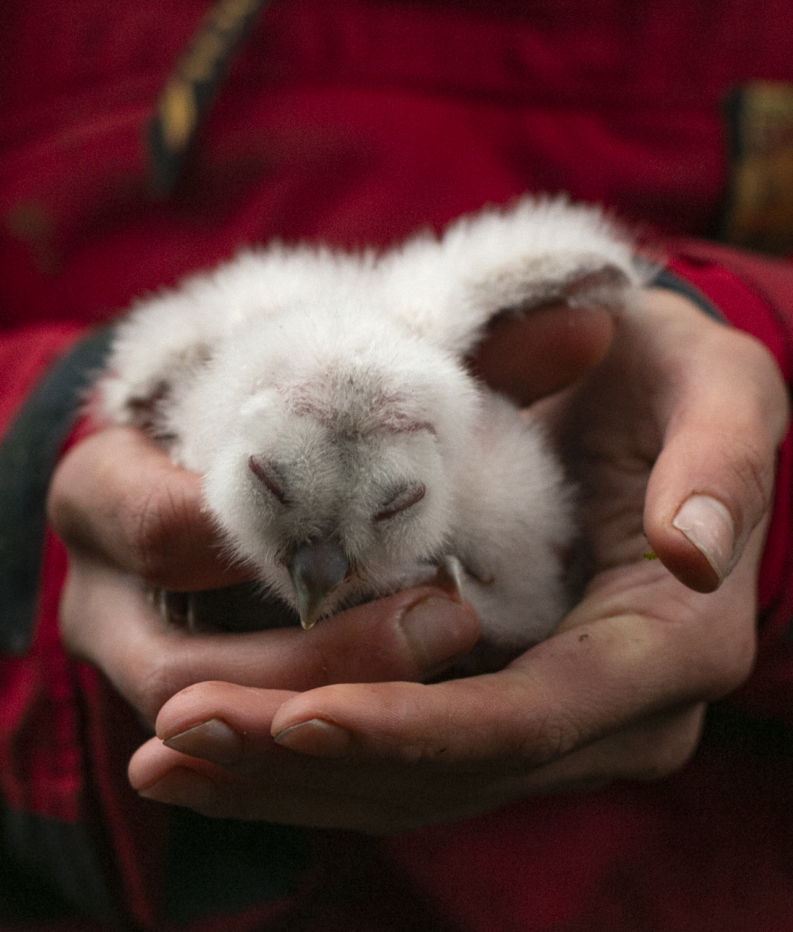
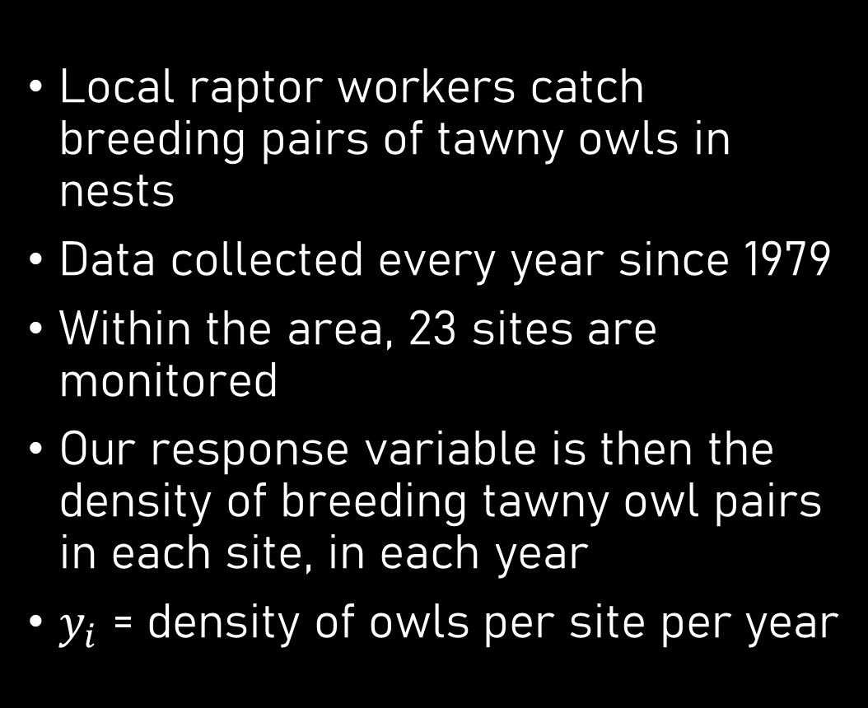
Our response variable
Local raptor workers catch breeding pairs of tawny owls in nests
Data collected every year since 1979
Within the area, 23 sites are monitored
Our response variable is then the density of breeding tawny owl pairs in each site, in each year
$y_{i}$ = density of owls per site per year

Slide 5
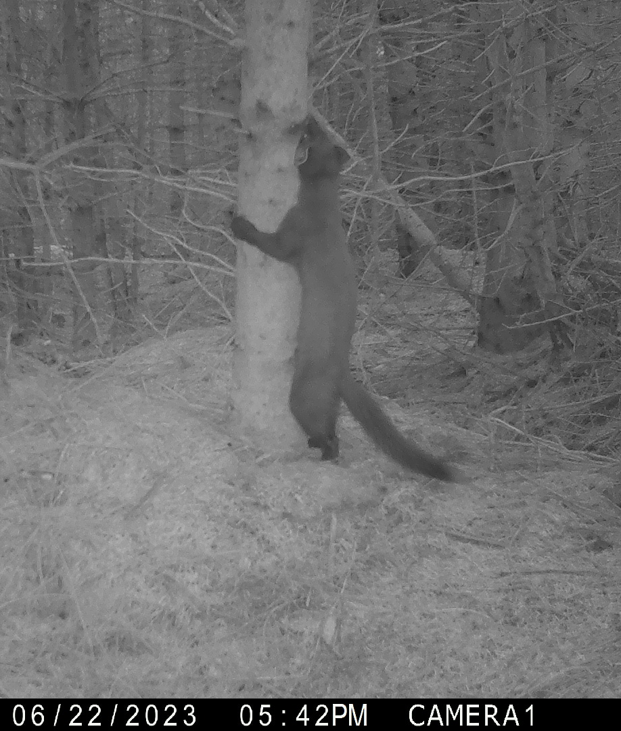
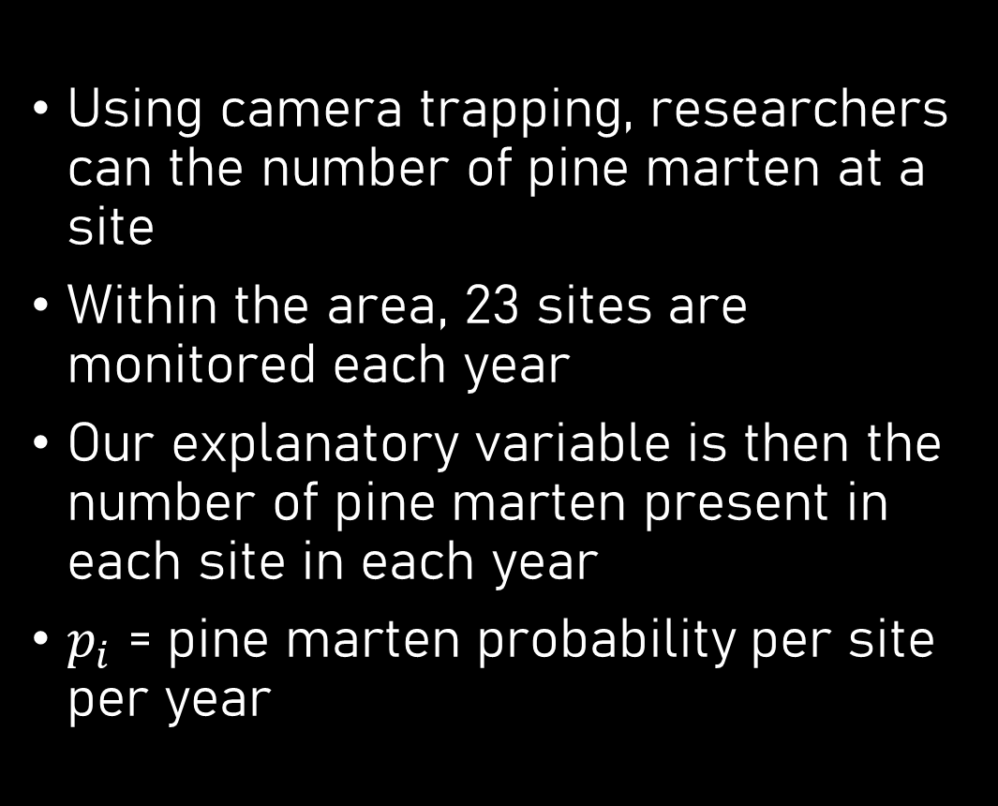
Our explanatory variable
Using camera trapping, researchers can the number of pine marten at a site
Within the area, 23 sites are monitored each year
Our explanatory variable is then the number of pine marten present in each site in each year
$p_{i}$ = pine marten probability per site per year

Slide 6

Question to model
We want to understand how owl density respond to pine marten occupancy
$y_{i}$ is owl density
$p_{i}$ is pine marten occupancy
Our current toolkit:
  $y_{i}∼Normal(μ_{i}, σ_{i})$
  $μ=β_{0}+β_{1}×x_{i}$
Merging these together:
  $y_{i}∼Normal(μ_{i}, σ_{i})$
  $μ_{i}=β_{0}+β_{1}×p_{i}$

Slide 7
Get to know your data

Slide 8
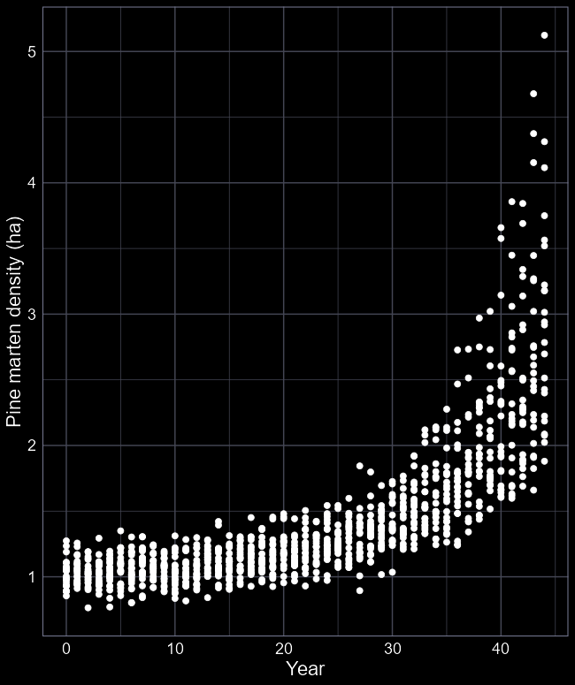
Pine marten time series
Very low densities for first ca. 30 years
Now up to ca. 3 pine martens per ha
Do you learn anything about the system from this figure?
Do you envisage any problems when we come to analyse this data?

Slide 9
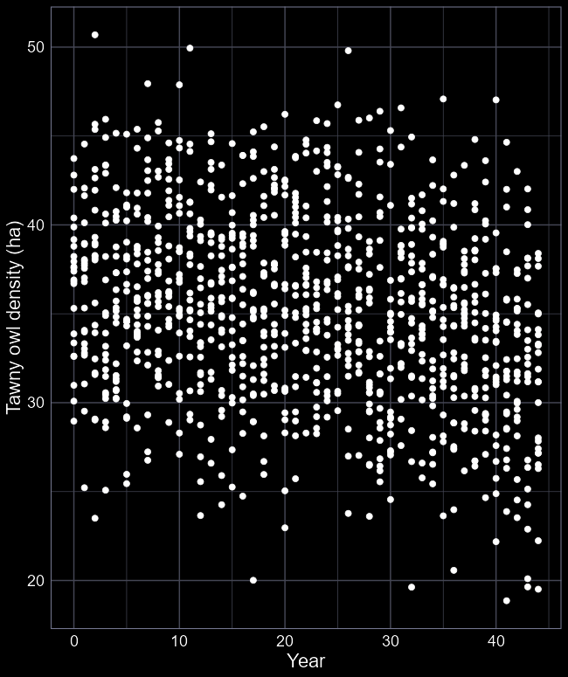
Tawny owl time series
Tawny owls look somewhat stable
Should we stop here and say pine martens are not predating tawny owls?
What would a better visualisation be?

Slide 10
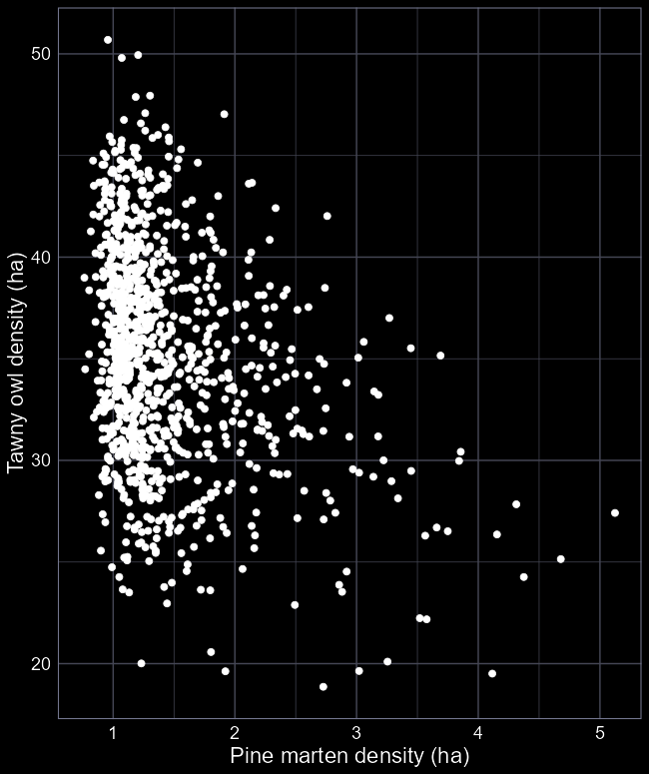
Tawny versus pine
Relationship a little clearer now
  But definitive?
Why the big bulk of observations towards the left of the figure?
Should we be concerned?

Slide 11
What do we take away
If there is a relationship, is it positive or negative?
How strong is that relationship?
How many tawny owls do we gain or lose for each additional pine marten?
If pine marten densities increase to 5 per ha, are tawny owls going to go extinct?
Should we intervene?

Slide 12
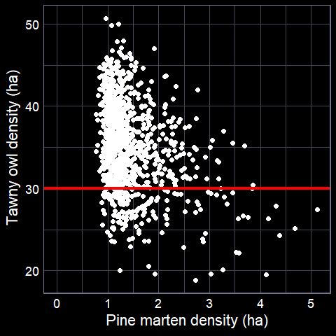

We need two pieces of information
To answer our questions, we need two pieces of information
  What is the intercept ($β_{0}$)?
  What is the slope ($β_{1}$)?
An infinite number of possible combinations
How do we figure out which one is best?

Slide 13
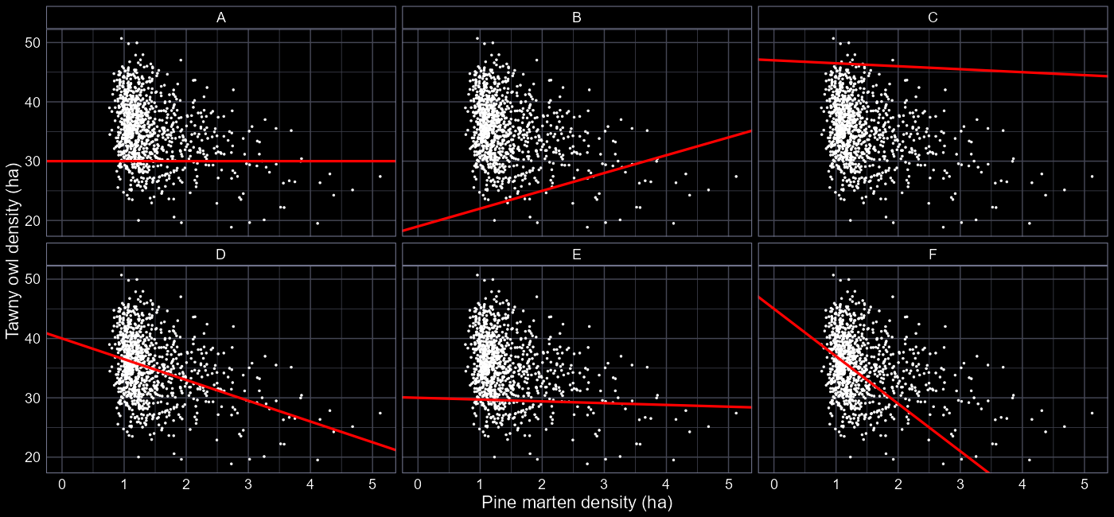






Which do you prefer?
$$β_{0}=30, β_{1}=0$$
$$β_{0}=19, β_{1}=3$$
$$β_{0}=47, β_{1}=−0.5$$
$$β_{0}=39, β_{1}=−2$$
$$β_{0}=30, β_{1}=−0.3$$
$$β_{0}=45, β_{1}=−8$$

Slide 14
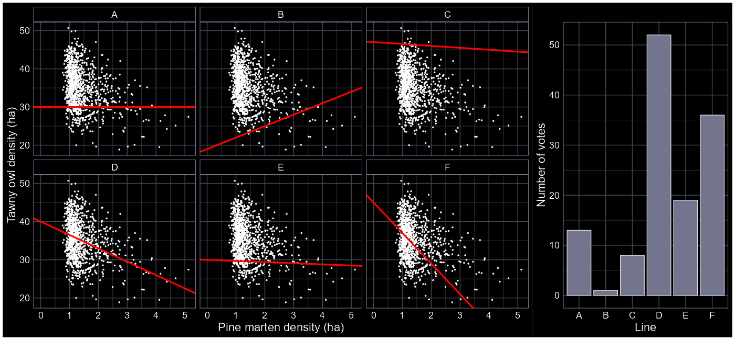
Which do you prefer?

Slide 15
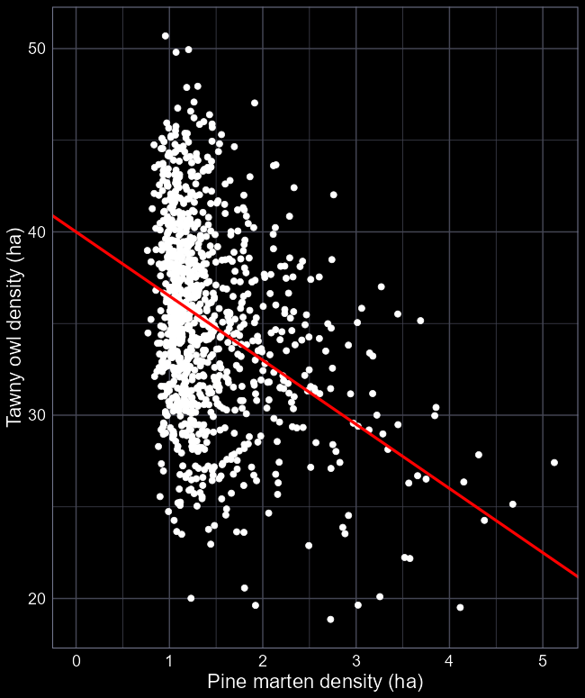
Line of best fit
When doing this by eye, we’re trying to fit a line that’s “balanced”
  As many points above as below the line
The difference between the line and each point is called the residual error
  Residual = “remaining” or “left behind”

Slide 16
Model fitting
We did this line ourselves but we’re subjective
And we don’t want to gather a thousand people to vote every time we want to fit a model
And we want to consider more than 6 different combinations for each parameter
How do we do that?

Slide 17
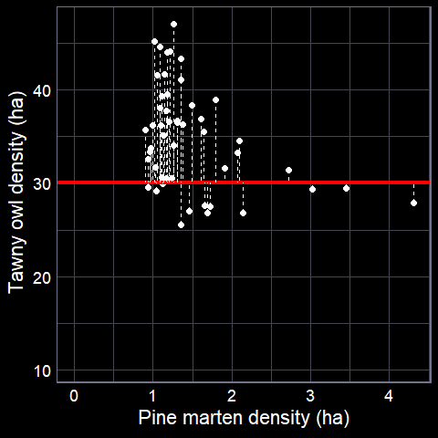
Residual error
We can use residual error as a metric for evaluating each parameter combination
For each parameter combination the model tries, there is residual error for each observation
How would you use these residuals to figure out which parameters work best?

Slide 18
MaCHiNe LEarNiNg

Slide 19
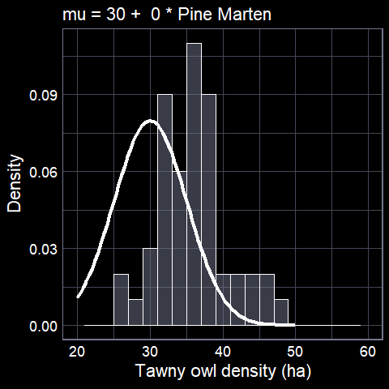
Using residuals we can find the parameter combination that gives best fit

Slide 20
Artificial intelligence
For each parameter combination
We get a likelihood value
Likelihood expresses how “likely” parameters match the observed data
We want to likelihood to be as high as possible
Maximum Likelihood Estimate (MLE)
But in practice, it is computationally easier to minimise

Slide 21
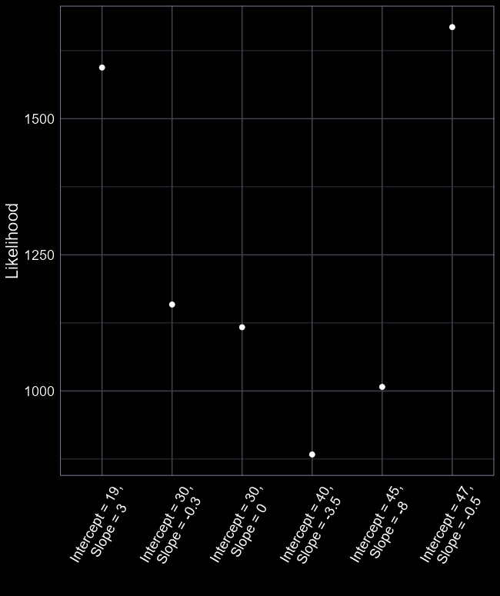
MLE
The worst parameter
values (of those tried)
All the computer must do is:
Try a couple of different parameter values for each parameter
Figure out which combination get the Likelihood as small as possible
Report to the user (us) what the best parameter combination was
The best parameter
values (of those tried)

Slide 22
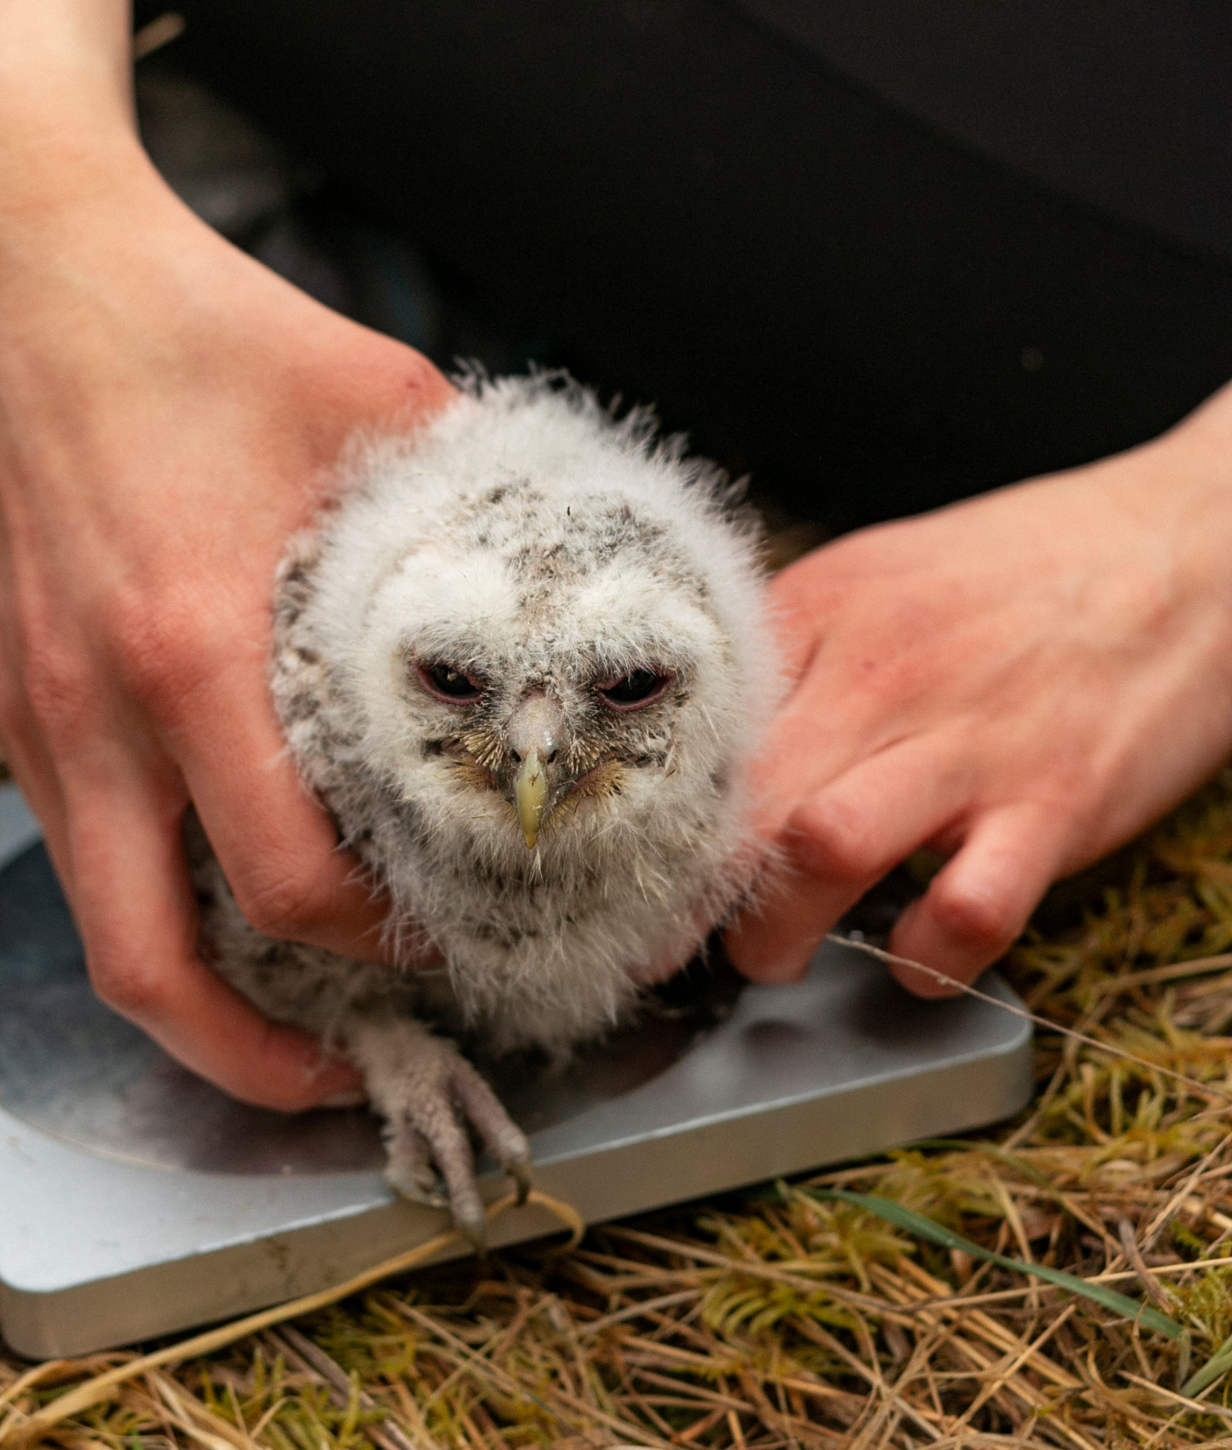

What do we learn biologically?
Of the (very) crude approach we took to figure out which parameter values work best with the data, we learn:
  $β_{0}=40$
  $β_{1}=−3.5$
What do these numbers mean?

Slide 23

What do we learn biologically?
$$y_{i}∼Normal\left(μ_{i}, σ_{i}\right)$$
$$μ_{i}=β_{0}+β_{1}×p_{i}$$
If there are no pine marten ($p=0$), then:
$$μ_{i}=β_{0}+β_{1}×p_{i}$$
$$μ_{i}=β_{0}+β_{1}×0$$
$$μ_{i}=β_{0}+0$$
$μ_{i}=β_{0}$
and we get:
$$μ_{i}=β_{0}+0=β_{0}$$
$β_{0}$ is the intercept, when $p=0$
Our model suggests that when there are no pine marten, we would expect 40 tawny owls

Slide 24

What do we learn biologically?
$$y_{i}∼Normal\left(μ_{i}, σ_{i}\right)$$
$$μ_{i}=40+β_{1}×p_{i}$$
$β_{1}$ was estimated as -3.5
If there are 2 pine marten ($p=2$), then:
$40−3.5×2=33$ tawny owls
For every additional pine marten at a site, we lose 3.5 tawny owls
$β_{1}$ is the effect of pine martens on tawny owls

Slide 25
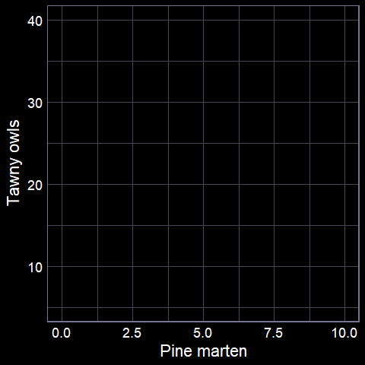
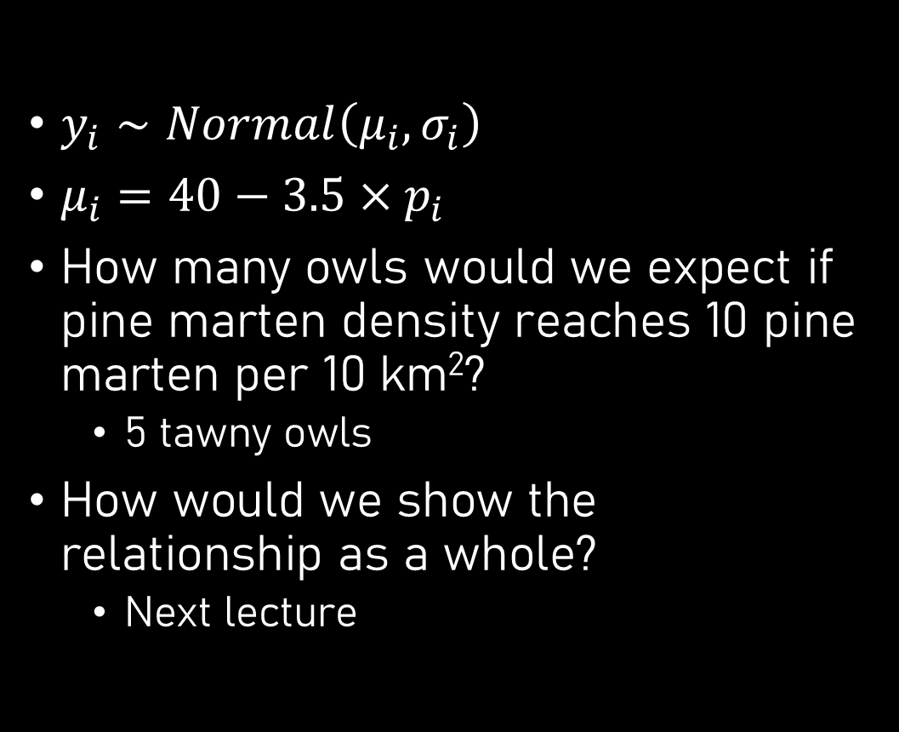
What do we learn biologically?
$y_{i}∼Normal\left(μ_{i}, σ_{i}\right)$
$μ_{i}=40−3.5×p_{i}$
How many owls would we expect if pine marten density reaches 10 pine marten per 10 km²?
  5 tawny owls
How would we show the relationship as a whole?
  Next lecture

Slide 26
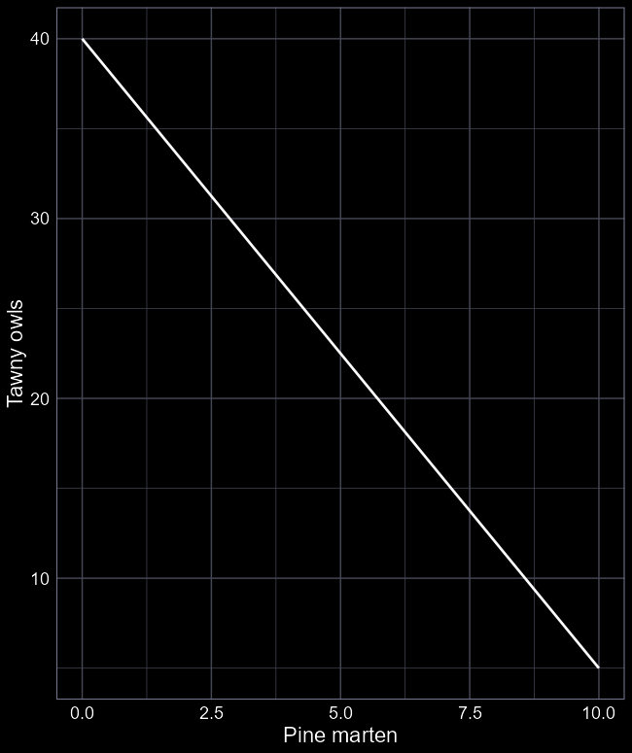
Answering our question
Will pine martens returning cause the systems (with tawny owls) to collapse?
Based on this model: “Yes”
But any caveats?
  Do you really know if it’s pine marten causing this decline?
  Is the data suitable for answering the question?
  What hidden assumptions are there?
Based on this model, being appropriately cautious: “Maybe”

Slide 27

tl;dr
We always start with a question
Statistics is merely how we answer the question
Start by plotting your data – get a feel for what’s going on
For linear models with continuous variables, we estimate an intercept ($β_{0}$) and a slope ($β_{1}$)
We use algorithms to estimate those values
We can then interpret what those parameter values mean biologically
  Are they “big”? Should we be concerned? Happy?

